Slide 1

Identification Of Annotators Agreement Using MicroBlogs Related To Grievances
Department of Computer Science
Gujarat University
MCA-5 Dissertation
Presented By :
Shivangi Chotaliya (50005)
Rathod Ajinkya (50024)
    Under the Guidance of :
Dr. Hardik Joshi

Slide 2
Abstract
We are working on tweets from the users that are related to Indian Railways and mostly are complaints.
The tweet can be grievance or non-grievance that is identified by the annotator.
The annotators are classified with the help of Cohen’s kappa score pinpoint precision.
Our task was to identify whether the annotators are reliable or not.
For evaluation, data has been retrieved from @RailMinIndia which is and official Account of Railway Government of India and annotated by various people.

Slide 3
Abstract
A confusion matrix is created based on annotators reviews. Cohen's Kappa is applied to the matrix and acquire the correct accuracy and evaluate if the tweet is grievance or non-grievance.
The implementation of the methodology is done using Django framework which is Python based programming language.

Slide 4
Keywords
Cohen’s kappa
Railway
Grievance
Non-grievance
Tweet
Tagger
Confusion matrix
Railway
Complaint
Annotators

Slide 5

Annotators
Annotator is someone who is an expert and who observes and comments or gives review on something.
Annotator is type of: commentator or an observer
  In our scenario, experts are those who are qualified enough to observe and classify tweets accordingly.

Slide 6

What is Grievance?
Something that is unfair and people usually complain/protest about it.
A grievance is kind of a formal complaint that is raised by a user towards Railway Ministry of India.
Our dissertation is related to the annotators who have worked on grievances obtained from the tweet handle of Railway Ministry of India.

Slide 7
Example of Complaint vs Grievance
For instance, “I officially mailed to the Railway Ministry of India”, is considered as Complaint.
A grievance, for example, is that some issue raised on twitter towards Railway Ministry of India.

Slide 8
Example of Grievance vs Non Grievance
Example:
  If some user complaints about the water supply problem, it will be considered as Grievance
  On the other hand, if any user complaints that the seat color is quite faded, it will be considered as Non Grievance.

Slide 9

Microblog
A social media site to which a user makes short or frequent posts.
Examples of Microblog are Tumblr, Facebook, Twitter, Reddit etc.
In this dissertation, we are as using Twitter as a part of Microblog.
Twitter allows to send small posts known as ‘tweets’ up to 140 characters in length.

Slide 10
Confusion Matrix

Slide 11
Steps(Example)
Collecting all the tweets from Railway official Accounts
  Examples:
  @RailMinIndia PNR 8535486976 dirty and used blanket and used bedroll given no one is responding very bad
  @sureshpprabhu @RailMinIndia Dear Sir I am travelling in 19046 train &amp; there is no water in toilets. The condition of the train is worst.

Slide 12
Cohen’s Kappa
For example, we collected 9 such tweets.
Let’s say we’re dealing with “yes” and “no” answers and 2 raters. Here are the ratings:
  Tagger1 = ['yes', 'no', 'yes', 'yes', 'yes', 'yes', 'no', 'yes', 'yes']
  Tagger2 = ['yes', 'no', 'no', 'yes', 'yes', 'yes', 'yes', 'yes', 'yes']

Slide 13
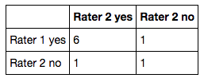

Slide 14
Research Problem

Slide 15
Research Problem
Our task was to identify whether the annotators are reliable or not.
Acquire the correct accuracy and evaluate if the tweet is grievance or non-grievance

Slide 16
Inter-rater agreement (Key Topic)
In statistics, inter-rater reliability, inter-rater agreement, or concordance is the degree of agreement among raters.
  Example: Google Photos.

Slide 17
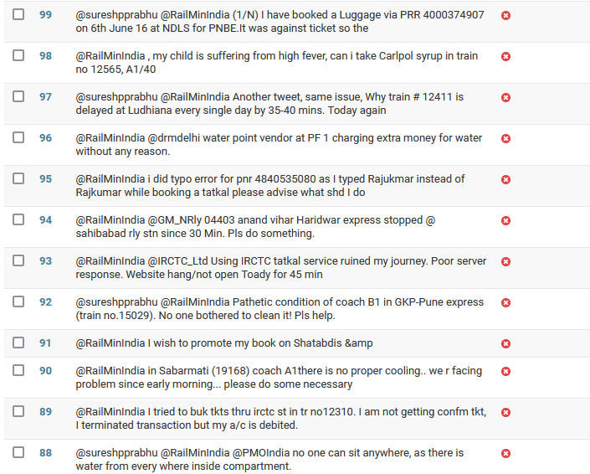

Slide 18
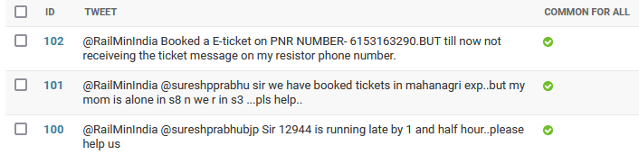

Slide 19
Inter-rater reliability techniques
Cohen's Kappa
Gwet's AC1
Scott's Pi
Bennett's S
Krippendorff’s alpha

Slide 20
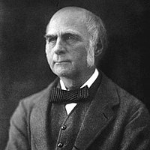
Cohen’s Kappa
The first mention of a kappa-like statistic
is attributed to Galton (1892) and
Smeeton (1985).
The seminal paper introducing kappa
as a new technique was published by Jacob Cohen
in the journal Educational and Psychological Measurement in 1960.

Slide 21
Cohen’s Kappa
Cohen's kappa coefficient (κ) is a statistic that is used to measure inter-rater reliability (and also inter-rater reliability) for qualitative (categorical) items.
It is generally thought to be a more robust measure than simple percent agreement calculation, as κ takes into account the possibility of the agreement occurring by chance.

Slide 22
Cohen’s Kappa
Cohen’s kappa is a metric often used to assess the agreement between two raters. It can also be used to assess the performance of a classification model.
For example, if we had two bankers, and we asked both to classify 100 customers in two classes for credit rating, i.e. good and bad, based on their credit worthiness, we could then measure the level of their agreement through Cohen's kappa.

Slide 23
Cohen’s Kappa
Similarly, in the context of a classification model, we could use Cohen’s kappa to compare the machine learning model predictions with the manually established credit ratings.
Like many other evaluation metrics, Cohen’s kappa is calculated based on the confusion matrix. However, in contrast to calculating overall accuracy, for example, Cohen’s kappa takes imbalance in class distribution into account and can therefore be more complex to interpret.

Slide 24
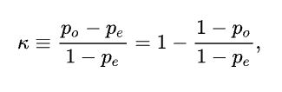
Cohen’s Kappa
Cohen's kappa measures the agreement between two raters who each classify N items into C mutually exclusive categories.
po is the relative observed agreement(Actual) among raters.
pe is a chance agreement(Expected) among raters.

Slide 25
Cohen’s Kappa
If the raters are in complete agreement then k=1.
If there is no agreement among the raters then k=0.
It is possible for the statistic to be negative, which implies that there is no effective agreement between the two raters or the agreement is worse than random.

Slide 26
Steps(Example)
Collecting all the tweets from Railway official Accounts
  Examples:
  @RailMinIndia PNR 8535486976 dirty and used blanket and used bedroll given no one is responding very bad
  @sureshpprabhu @RailMinIndia Dear Sir I am travelling in 19046 train &amp; there is no water in toilets. The condition of the train is worst.

Slide 27
Cohen’s Kappa
For example, we collected 9 such tweets.
Let’s say we’re dealing with “yes” and “no” answers and 2 raters. Here are the ratings:
  Tagger1 = ['yes', 'no', 'yes', 'yes', 'yes', 'yes', 'no', 'yes', 'yes']
  Tagger2 = ['yes', 'no', 'no', 'yes', 'yes', 'yes', 'yes', 'yes', 'yes']

Slide 28
Cohen’s Kappa
Turning these ratings into a confusion matrix:
 | Tagger 2 Yes | Tagger 2 No
Tagger 1 Yes | 6 | 1
Tagger2 No | 1 | 1

Slide 29
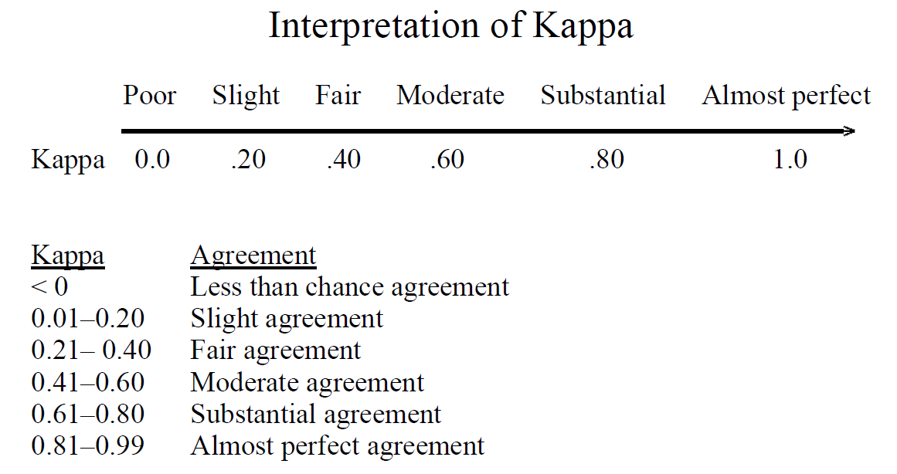
Cohen’s Kappa

Slide 30
Cohen’s Kappa
Observed agreement = (6 + 1) / 10 = 0.7
Chance agreement = probability of randomly saying yes (P_yes) + probability of randomly saying no (P_no)
P_yes = (6 + 1) / 10 * (6 + 1) / 10 = 0.49
P_no = (1 + 1) / 10 * (1 + 1) / 10 = 0.04
Chance agreement = 0.49 + 0.04 = 0.53
Since the observed agreement is larger than chance agreement we’ll get a positive Kappa.
Kappa = 1 - (1 - 0.7) / (1 - 0.53) = 0.36 (Fair Agreement)

Slide 31
Cohen’s Kappa Special Cases
Less than chance agreement
    Tagger1 = ['no', 'no', 'no', 'no', 'no', 'yes', 'no', 'no', 'no', 'no']
    Tagger2 = ['yes', 'no', 'no', 'yes', 'yes', 'no', 'yes', 'yes', 'yes', 'yes']
    cohen_kappa_score(rater1, rater2)
    -0.2121
If all the ratings are the same and opposite
    This case reliably produces a kappa of 0
    Tagger1 = ['yes'] * 10
    Tagger2 = ['no'] * 10
    cohen_kappa_score(rater1, rater2)
    0.0

Slide 32
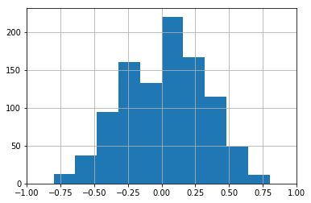
Cohen’s Kappa on Random Ratings
10 random ratings for each rater (random sample of 1,000 inter-rater Kappa calculations)

Slide 33
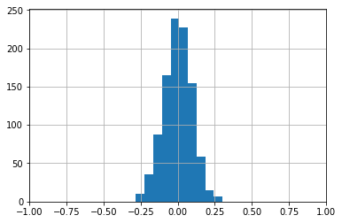
Cohen’s Kappa on Random Ratings
100 random ratings for each rater (random sample of 1,000 inter-rater Kappa calculations)

Slide 34
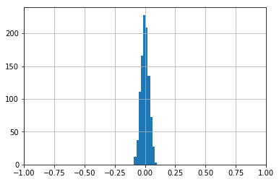
Cohen’s Kappa on Random Ratings
1000 random ratings for each rater (random sample of 1,000 inter-rater Kappa calculations)

Slide 35
Limitations of Cohen’s Kappa
Cohen's Kappa only applied to 2 raters rating the exact same items.
κ = 0; when the observed allocation is apparently random

Slide 36
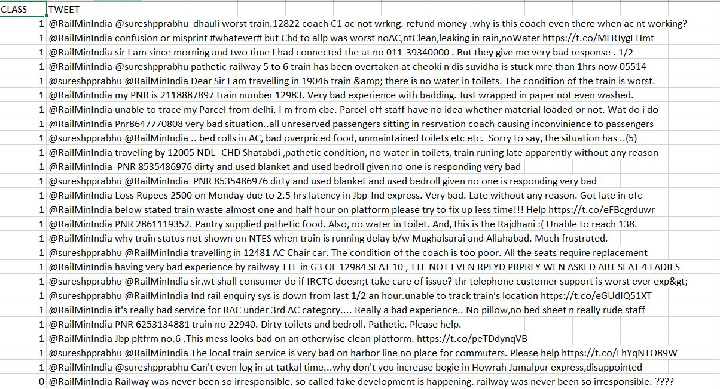

Slide 37
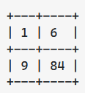
Our Approach
Cohen’s Kappa is known to have limitations for skewed datasets.
Consider following matrix :
The above example has an observed agreement of 0.85 but the Cohen' Kappa is 0.04.
Cohen’s kappa is way higher or lower for balanced data.

Slide 38
How will we achieve it?
Our algorithm will use Gwet AC’s or Krippendorff’s alpha algorithm based on conditions.

Slide 39
Another Limitation
Kappa can be applied to 2 raters only. If you want to find inter rater reliability of 3 or more raters, its not possible.

Slide 40
How will we overcome this?
rater1 = [0, 1, 0, 1, 1, 1, 1, 1, 1, 1, 0]
rater2 = [1, 1, 1, 1, 1, 1, 1, 1, 1, 1, 0]
rater3 = [1, 1, 1, 1, 1, 0, 1, 1, 1, 1, 0]

Slide 41
import agreement
raters = [rater1, rater2, rater3]
taskdata = []
for rater in raters:
taskdata +=[[raters.index(rater), str(i),str(rater[i])] for i in range(0,len(rater))]
ratingtask = agreement.AnnotationTask(data=taskdata)
kappa = ratingtask.kappa()

Slide 42
Literature Survey – Research Papers
Title: A Simplified Cohen’s Kappa for Use in Binary Classification Data Annotation Tasks
Authors: Juan Wang, Yongyi Yang, Bin Xia
Published In: IEEE Access
Year of Publication: 2019

Slide 43
Introduction
Binary Classification
    Binary classification refers to those classification tasks that have two class labels.
    Examples :Binary classification of Railway Tweets are annotated by Annotators which tweets are Grievance or non-Grievance.
    Typically, binary classification tasks involve one class that is the normal state and another class that is the abnormal state.

Slide 44
Paper: Cohen’s kappa
Cohen's kappa coefficient (κ) is a statistic that is used to measure inter-rater reliability for qualitative (categorical) items.
In binary classification tasks, Cohen’s kappa is often used as a quality measure for data
annotations, which is inconsistent with its original purpose as an inter-annotator consistency / inter-rater reliability (two or more people agree on the same point) measure.
Therefore, it is important to assess(judge or form the opinion about something) the quality of annotations prior to their use in supervised learning

Slide 45

One such metric is Cohen’s kappa coefficient which has been accepted as the de facto standard for measurement of inter-annotator agreement
Mathematically, Cohen’s kappa is defined as:
where pA is the observed(actual) relative agreement between two annotators, and pE is the hypothetical (expected) probability

Slide 46
Cohen’s kappa is also cited for its problems associated with bias and prevalence in the interpretation of kappa Values.
The bias problem is caused by the difference in the distribution of annotation categories of the two annotators.
The analytic relationship between kappa and commonly used classification metrics (e.g., sensitivity and specificity) is non-linear, and thus is difficult to be applied for interpretation of the classification performance of the annotations.

Slide 47
Paper: Methods
Annotation Generation Model
Cohen’s Kappa coefficient
Sensitivity and Specificity
Kappa Approximation

Slide 48
Research Paper: A random forest classifier for lymph diseases
The performance of classifier, and hence the quality of selected features, will be evaluated also by means of Cohen’s kappa coefficient or kappa statistic (KS) to measure the agreement between predicted and observed values of a dataset while correcting the agreement that occurs by chance
The cost of error must also be taken into account, while making such assessments

Slide 49
Research Paper: A Simplified Cohen’s Kappa for Use in Binary Classification Data Annotation Tasks
Cohen’s kappa is also cited for its problems associated with bias and prevalence in the interpretation of kappa values
The bias problem is caused by the difference in the distribution of annotation categories of the two annotators, while the prevalence problem arises when the underlying distribution of class categories is skewed

Slide 50
Research Paper: Facing Imbalanced Data - Recommendations for the Use of Performance Metrics
Cohen’s kappa is a coefficient developed to measure agreement among observers.
  It shows the observed agreement normalized to the agreement by chance
Krippendorff’s α-reliability measures the observed disagreement normalized to the observed disagreement

Slide 51
Technologies Used

Slide 52
Programming Language
    Python
Library used
    pandas
    metrices
    pylab
    seaborn
    matplotlib

Slide 53
References
https://towardsdatascience.com/inter-rater-agreement-kappas-69cd8b91ff75
https://www.wikiwand.com/en/Cohen%27s_kappa#/History
https://machinelearningmastery.com/types-of-classification-in-machine-learning/
https://www.sciencedirect.com/science/article/pii/S016740481730250X
https://smallbusiness.chron.com/crowdsource-twitter-34435.html
https://github.com/amirziai/learning/blob/master/statistics/Inter-rater%20agreement%20kappas.ipynb

Slide 54
Let’s move on to Implementation Part

Slide 55
Thank you,
Any questions ?

